Slide 1

Grouping Clothing Stores
AN EXPLORATORY STUDY

Slide 2
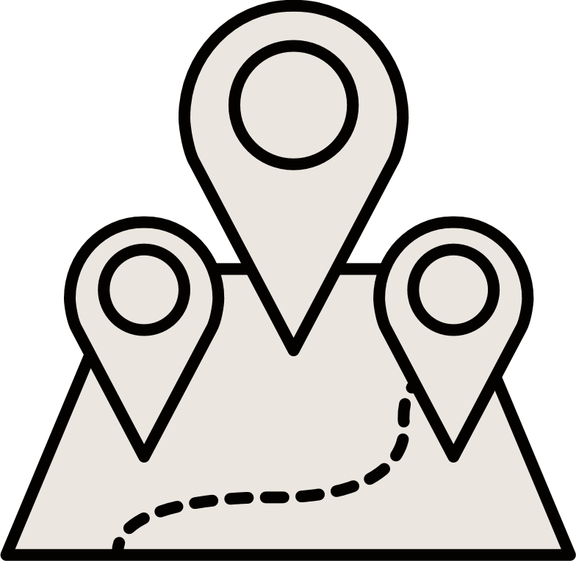
Problem Presentation
Is it possible categorize clothing stores in groups, in the city of Recife through the similarity of nearby establishments?

Slide 3
50 Recife
Cloth Store
Nominatim
Stores district
VENUES
Recife city hall website scrap
Data Presentation
F
EXPLORE
200 locations categories 200 meters away
CATEGORIES
Creation of the ontological dictionary
I.R.M.M.M.D.M.*
*IBGE metrics

Slide 4
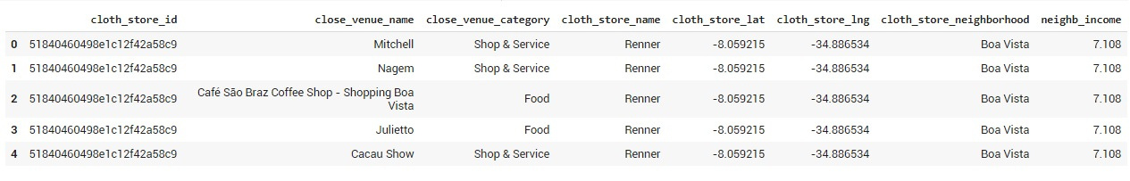
All data DataFrame

Slide 5

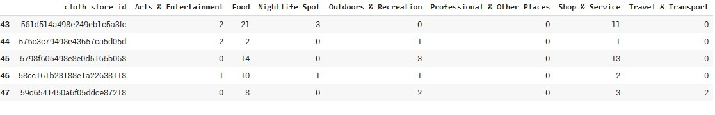

Pre-processing explanation
Isolate the category column in a new DataFrame
Transform unique values into dummies
Put the store ID column back
Group by ID and sum the categories
Remove the ID column again
Put the values in the same scale (normalization)
Do the clustering!

Slide 6
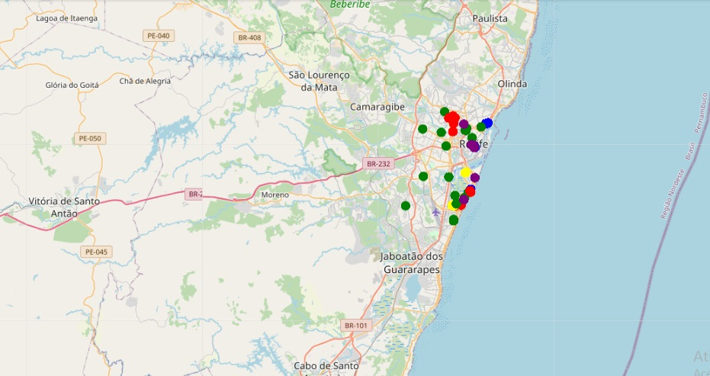
Clustering visualization

Slide 7
Conclusion
Not the best way
Based on the quantity and quality of the available data in here, for the application of this specific algorithm and methodology, the categorization inferences are very fragile.
Maybe with another API
Certainly with more variables
Foursquare gradually lost popularity in Brazil, and today, there are few records of establishments and users feeding the platform.
Other interesting information wold be variables like: the google price sorter avaible in the search information from all nearby locations, "razão social" informations of active and failed clothing stores, etc.

